Slide 1
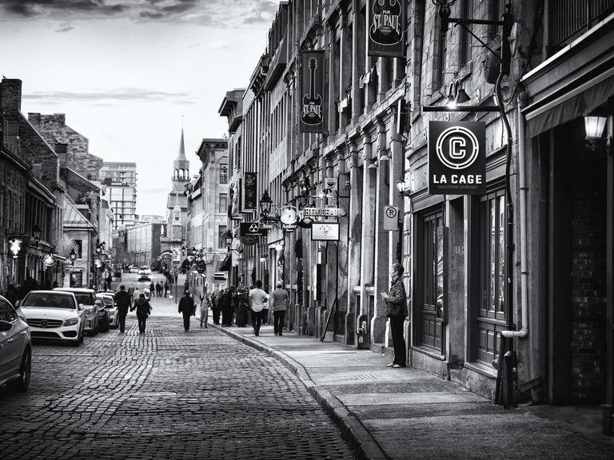
FUNDAMENTAL OF IMAGE PROCESSING
SCSV 3213

Slide 2
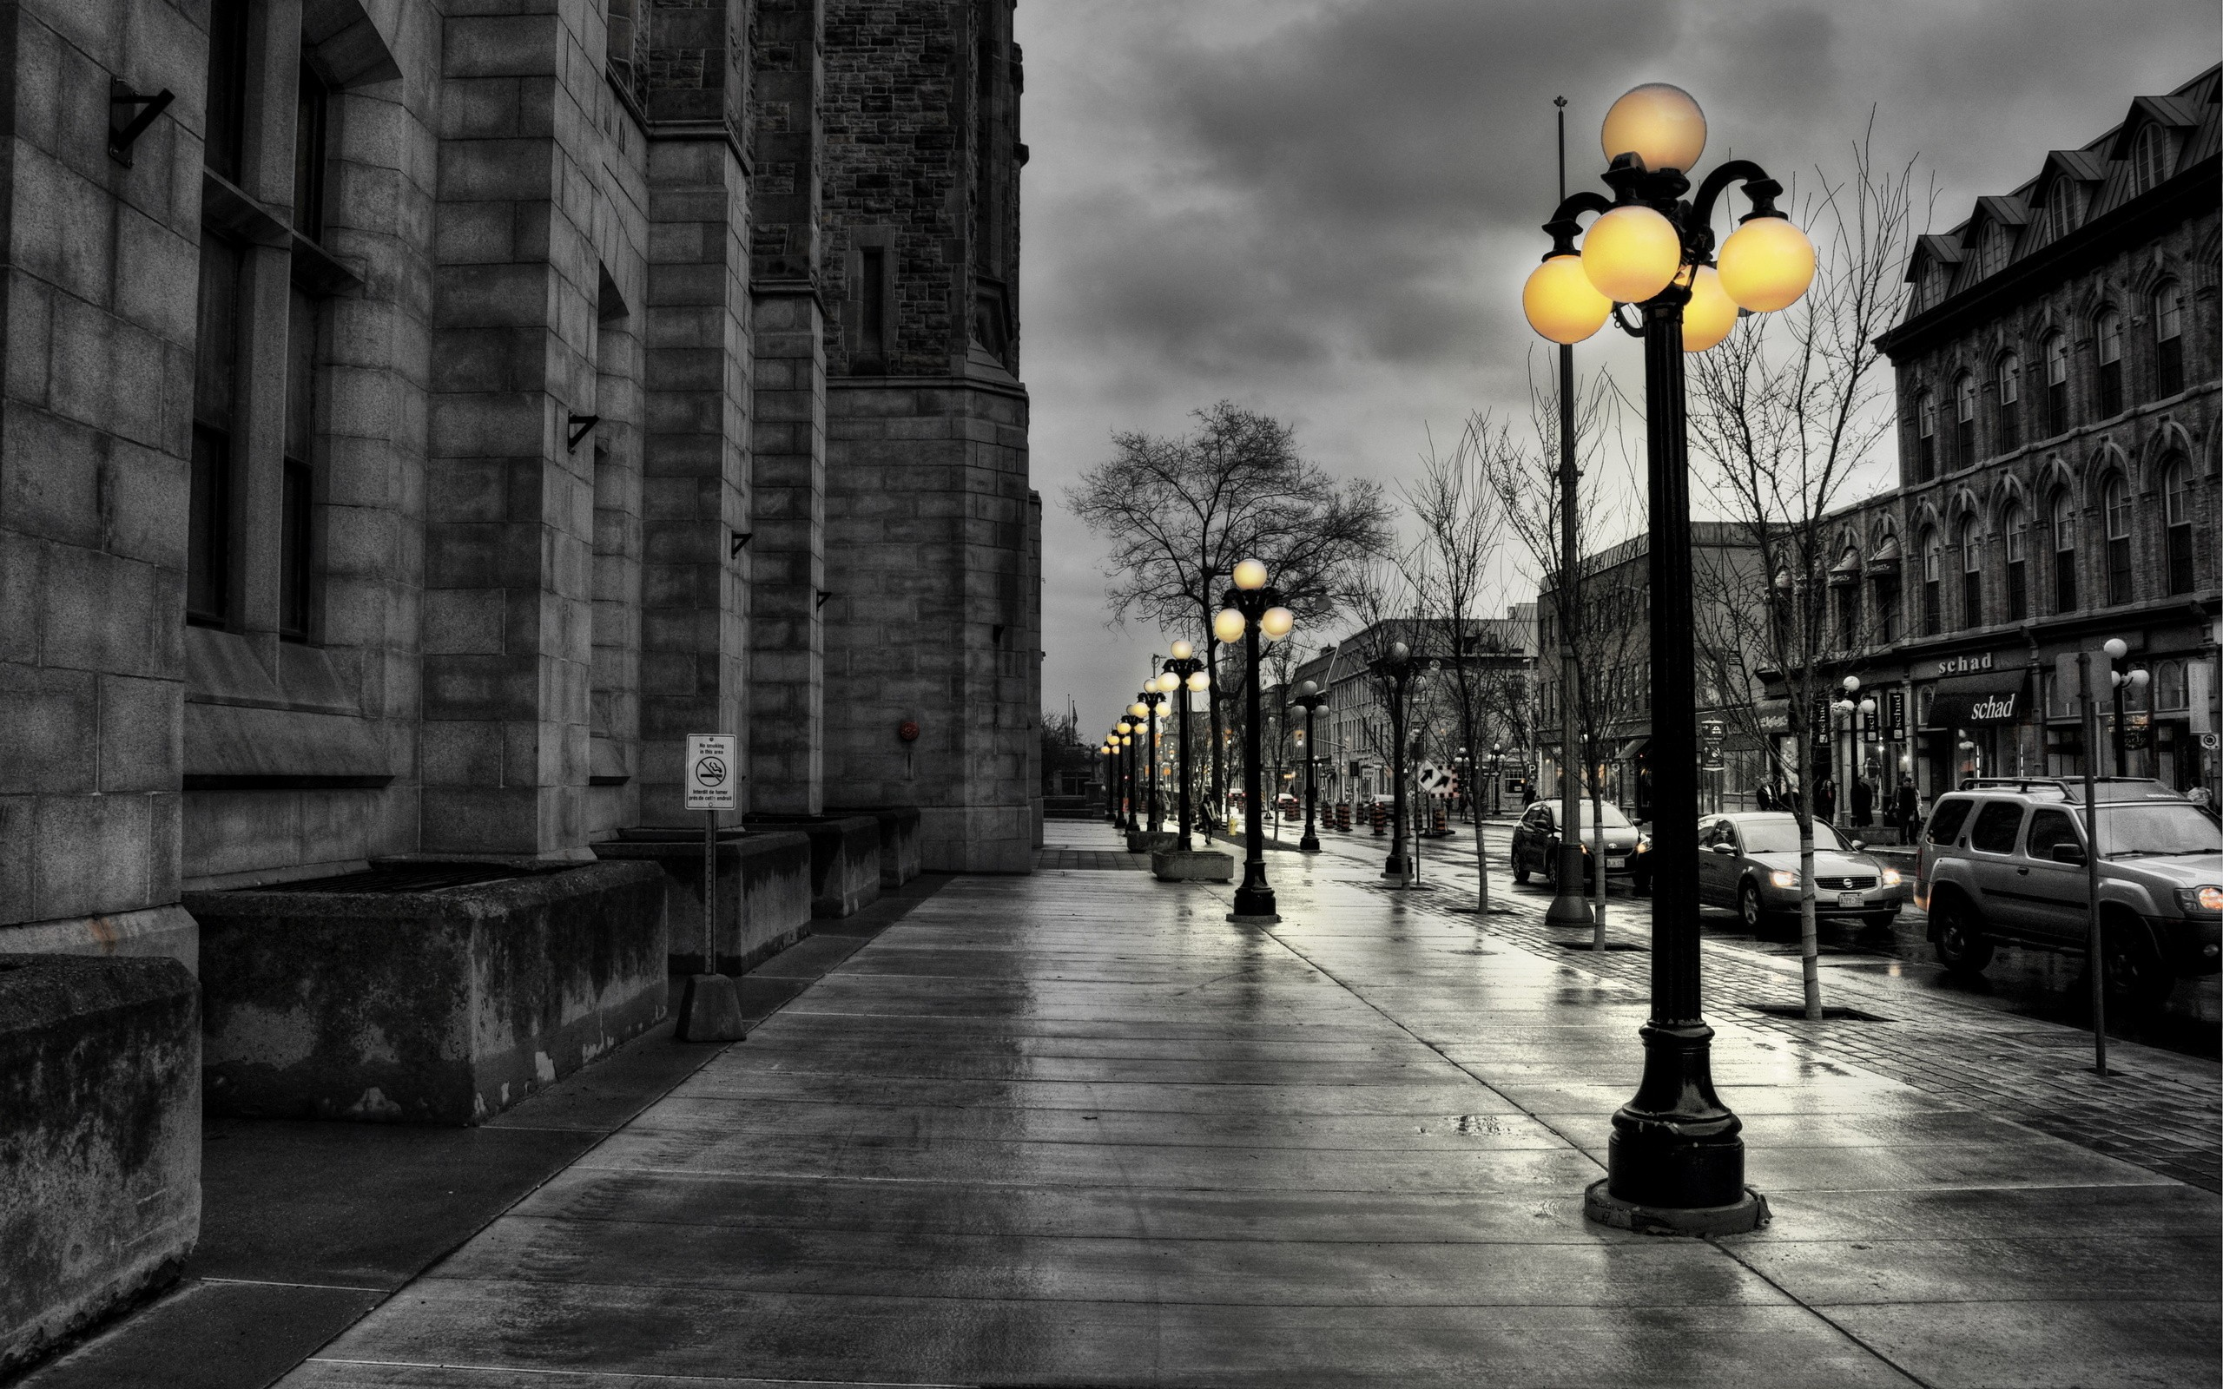
ASSIGNMENT 3 IMAGE RESTORATION & ENHANCEMENT
Prepared by: TAN SEE JOU A17CS0218

Slide 3
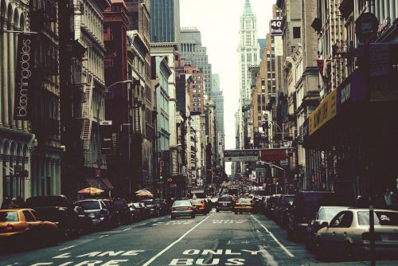
TASK
Restore and enhance old images with general problems like noise, not clear and so on, by applying enhancement methods with Matlab.
There are a few sets of problem images have been prepared for testing, in *png and *jpg extension.

Slide 4
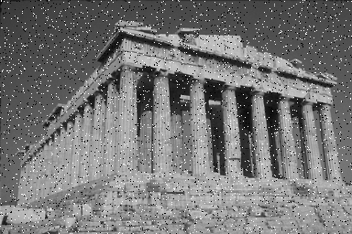
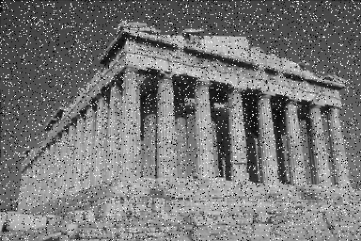
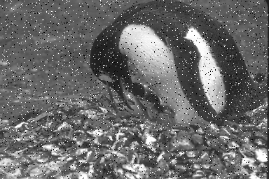
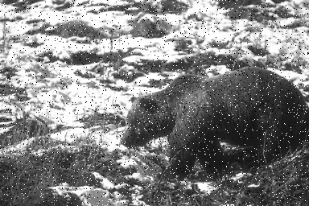
IMAGEs WITH NOISE
Different level of noise (up to 30%)
Parthenon 5%
Parthenon 10%
Parthenon 15%
Different images with noise
Penguin 5%
Polar Bear 5%

Slide 5
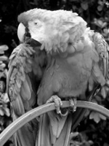
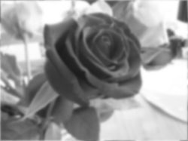
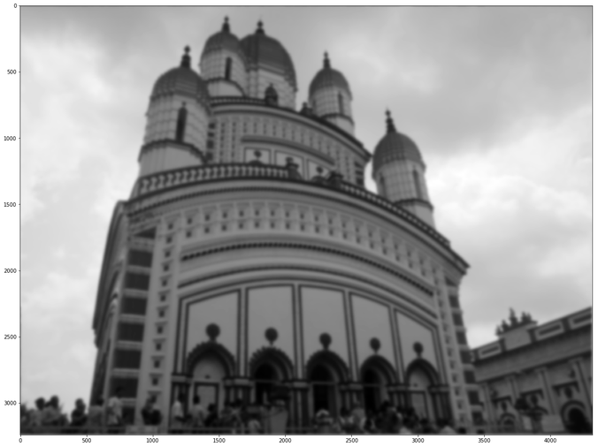
Blurred image

Slide 6
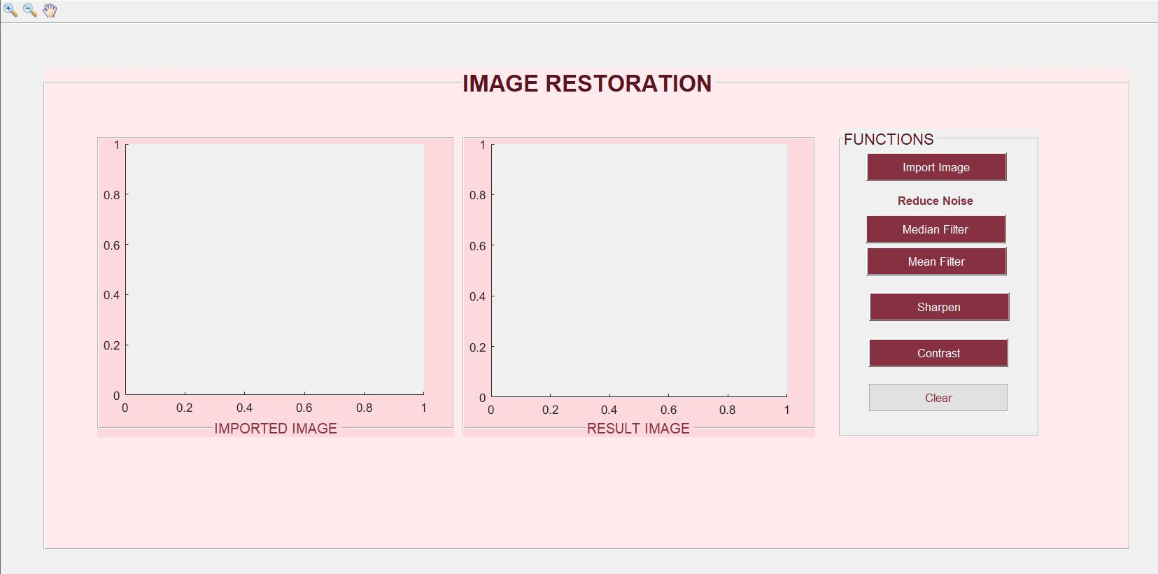
GUI
Zoom in and out of the image
Move the image
Browse the image from folder
Apply median filter to reduce noise
Apply mean filter to reduce noise
Sharpen blurred image
Add contrast
Clear both images
Original problem image
Restored Image
(all methods applied at here)

Slide 7
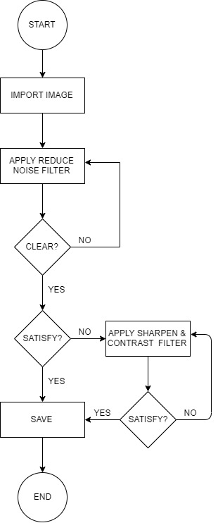
USER MANUAL
I. Reducing noise
Import image from file (*png)
Choose the type of noise reduce filter *Recommend median filter. (can apply several times)
a. If the result image is clear, restoration done, else, apply sharpen filter and contrast filter to get a clear image.
I. Deblur image
Import image from file (*jpg)
Apply sharpen filter to get a clear image. (can apply several times)
Applied contrast filter to get more contrast image.

Slide 8
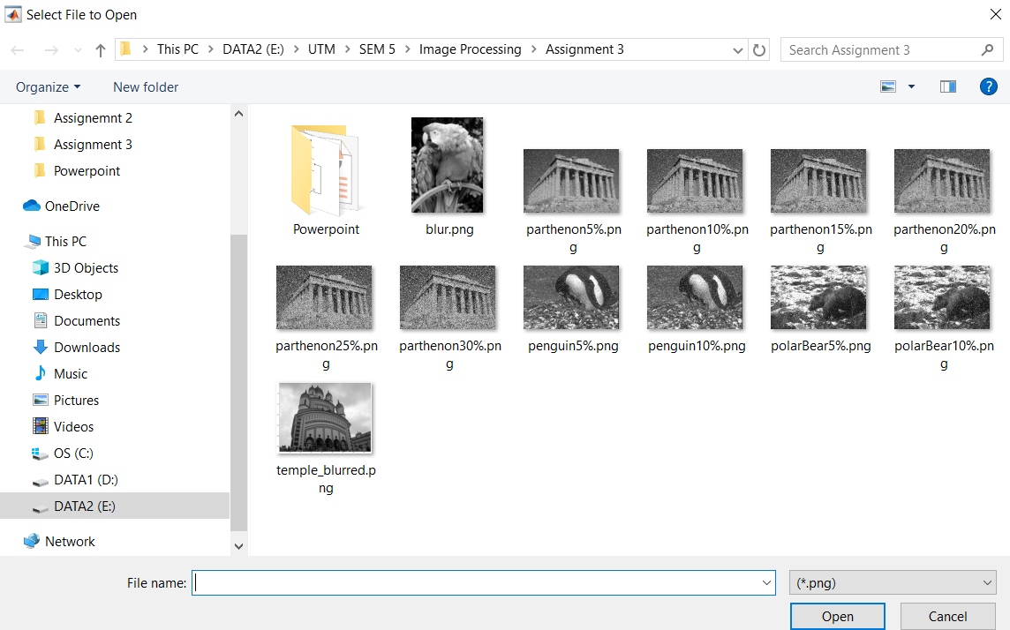
PROCESS FLOW: Reduce noise
1. Import noise image
Import an old image with noise from the folder (*png).
In this example, parthenon15% will be import.

Slide 9
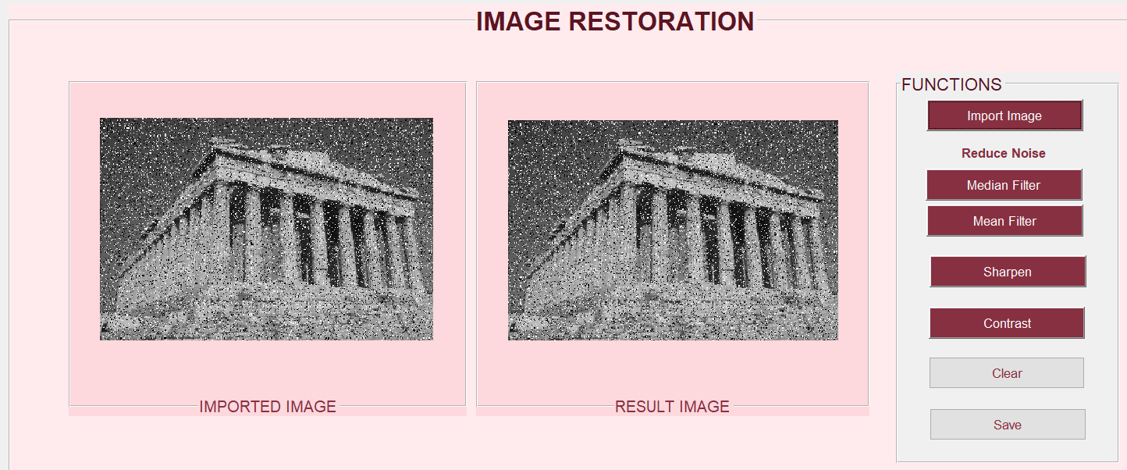
PROCESS FLOW: Reduce noise
2. Choose median filter to have a clear result.

Slide 10

PROCESS FLOW: Reduce noise
2. Resulted image[with median filter].
Most of the noise had been remove as compare to the imported image.

Slide 11
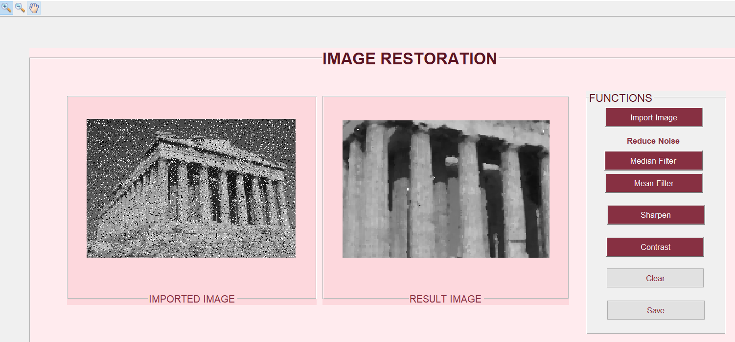
PROCESS FLOW: Reduce noise
3. Can zoom in and out with the magnifying tool.
There are tool for the user the zoom in and out to check the edited image easily.

Slide 12
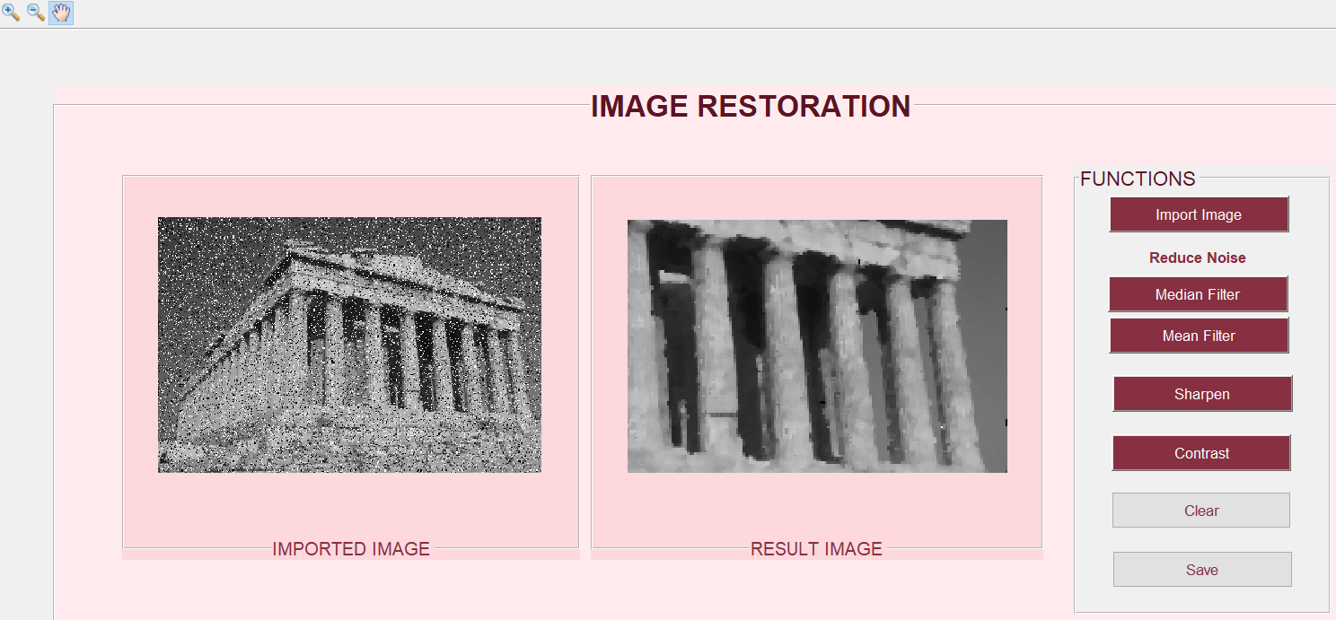
PROCESS FLOW: Reduce noise
4. Move the edited image with ‘hand’ tool.
There is tool for the user to move and check the edited image easily.

Slide 13
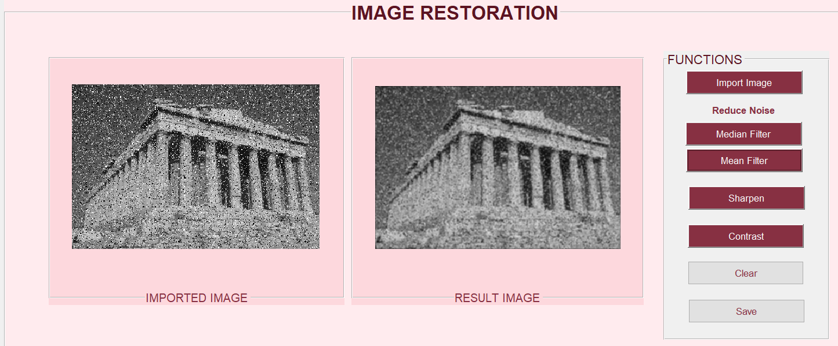
PROCESS FLOW: Reduce noise
*. Resulted image[with mean filter].
The noise cannot be reduce effectively when applied the mean filter on the same image(parthenon15%).

Slide 14
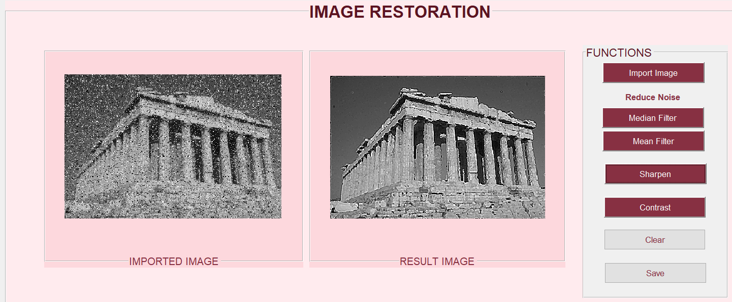
PROCESS FLOW: Reduce noise
5. Applied sharpen filter
The result image is more sharp as compare to before, more details can be seen.

Slide 15
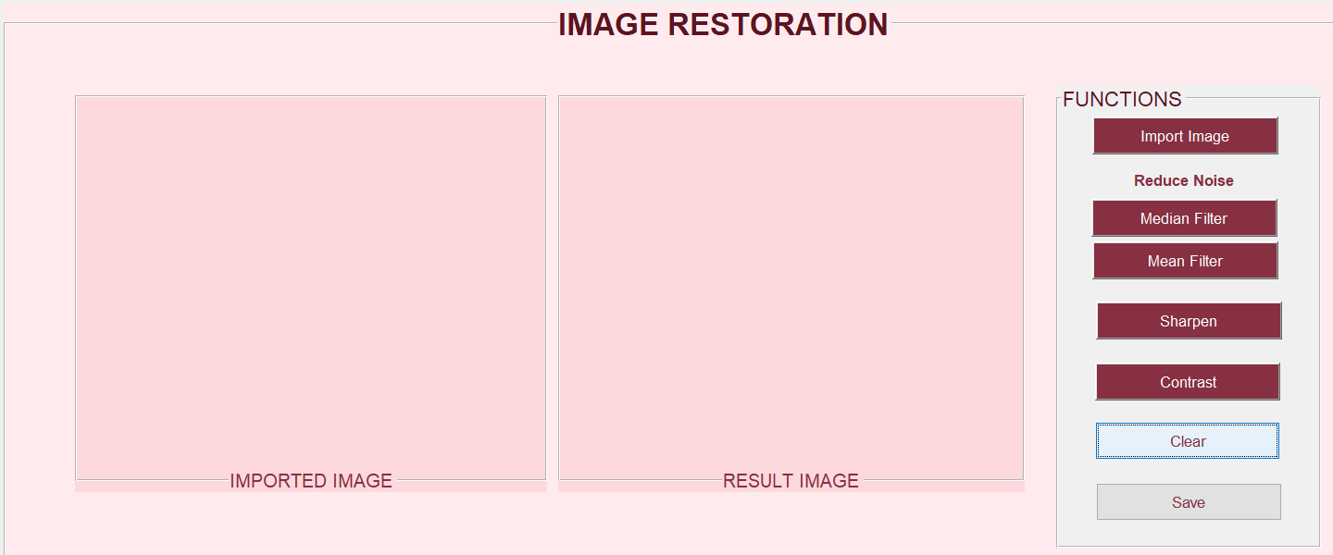
PROCESS FLOW: Reduce noise
6. Click clear button
Both images had been removed, and ready for next image.

Slide 16
PROCESS FLOW: Deblur Image
1. Import not cleaar image
Import an old not clear from the folder (*jpg or *png).
In this example, blur.png (which is the parrot image) will be import.

Slide 17
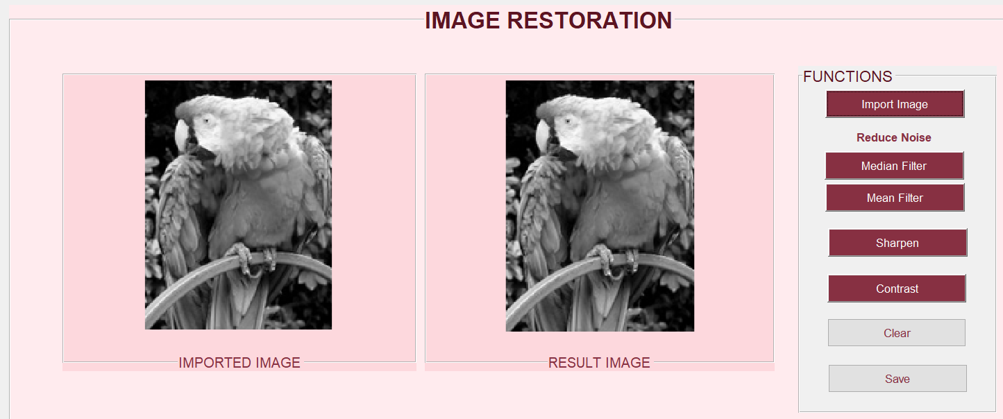
PROCESS FLOW: Deblur Image
2. Choose sharpen filter.

Slide 18
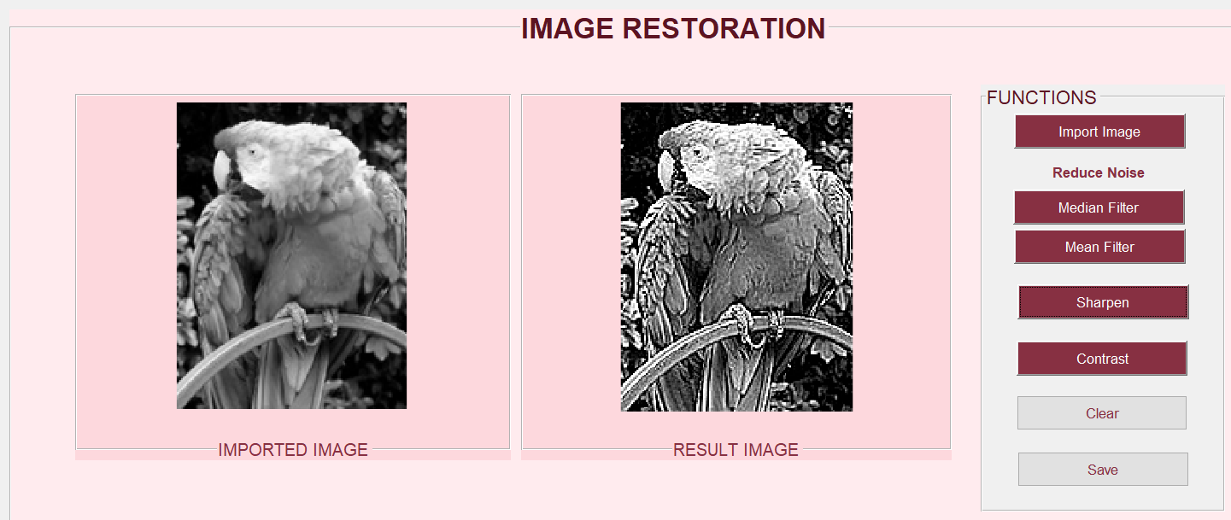
PROCESS FLOW: Deblur Image
2. Resulted Image.
The result image is more sharp and clear as compare to before, more details can be seen. [sharpen filter had been applied 3 times]

Slide 19
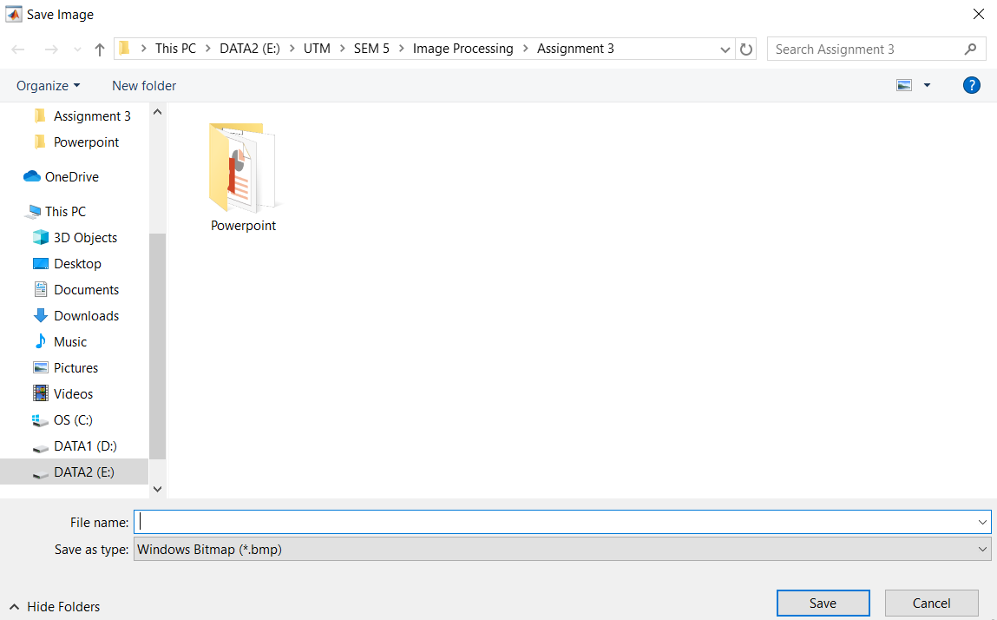
PROCESS FLOW: Deblur Image
3. Save Image.
User can save the edited image.

Slide 20
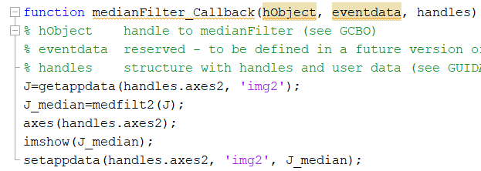

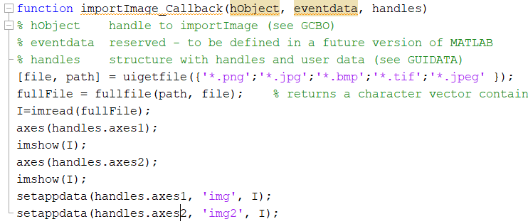

Function EXPLAINATION-I
function importimage_callback(hobject, eventdata, handles)
If the user click ‘median filter’, medianFilter_Callback function() will be called.
Last value stored at handles.axes2 is get by using getappdata() and store it in J.
Applied medfilt2() to J and stored it in J_median.
Showed the image and update the value stored in the handle.axes2, so that any further enhancement can be add on.
Image had been imported, and imread() use to read the image file.
Select axes and displayed the image on both axes.
Store the image, I, into the handle: handle.axes1, as name: img.
function medianfilter_callback(hobject, eventdata, handles)

Slide 21
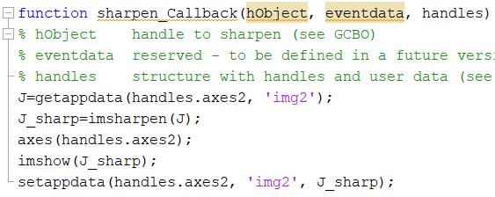
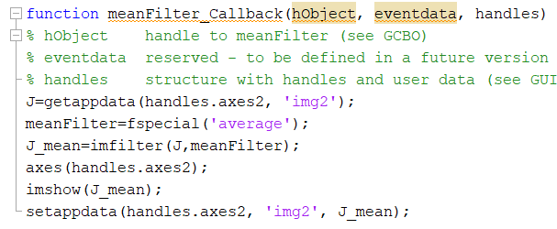
Function EXPLAINATION-II
function meanfilter_callback(hobject, eventdata, handles)
If the user choose ‘sharpen filter’, sharpen_Callback function() will be called.
Last value stored at handles.axes2 is get by using getappdata() and store it in J.
Applied imsharpen() to J and stored it in J_sharp.
Showed the image and update the value stored in the handle.axes2, so that any further enhancement can be add on.
If the use choose ‘mean filter’, meanFilter_Callback function will be called.
fspecial(‘average’) applied to the image, and stored in J_mean.
Show the image and update the value as same as the last step of median filter.
function sharpen_callback(hobject, eventdata, handles)

Slide 22
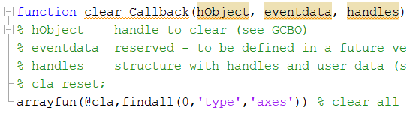
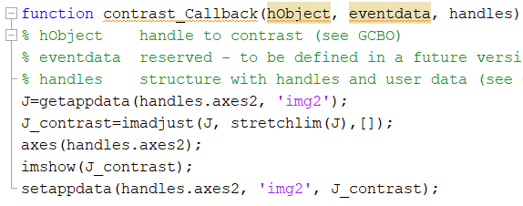
Function EXPLAINATION-III
function contrast_callback(hobject, eventdata, handles)
If the user choose ‘clear filter’, clear_Callback function() will be called.
Both the images from both axes will deleted and ready to restart again.
If the use choose ‘contrast filter’, contrast_Callback function will be called.
Imadjust(J, stretchlim(J), []) applied to the image, and stored in J_contrast.
Show the image and update the value as same as the last step of median filter.
function clear_callback(hobject, eventdata, handles)

Slide 23
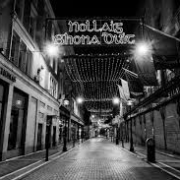
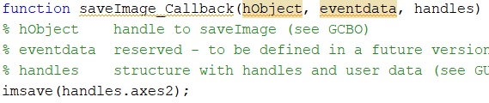
Function EXPLAINATION-IV
function saveImage_callback(hobject, eventdata, handles)
If the use choose ‘save’, save_Callback function will be called.
User can save the edited image.

Slide 24
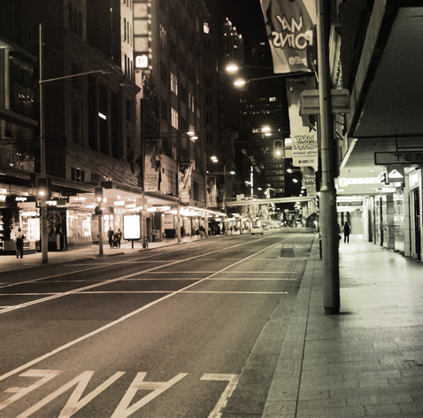
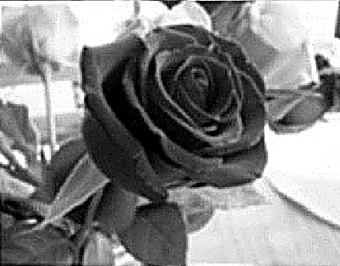
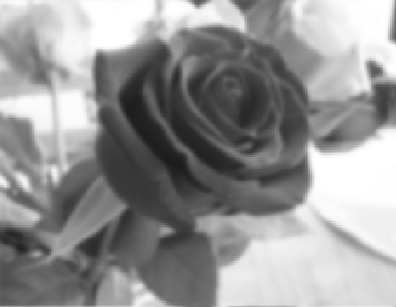
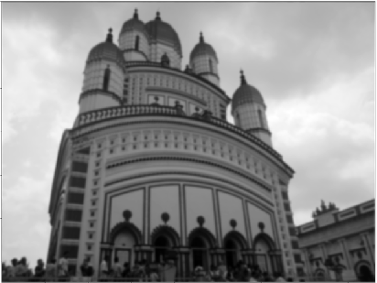
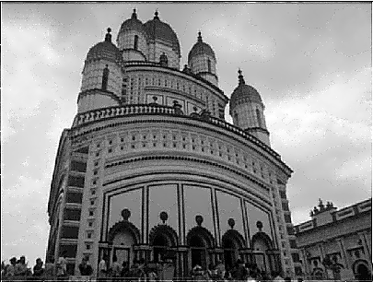
Others example image restoration
Sharpen
&
contrast

Slide 25
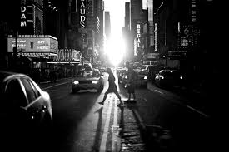
Thank you !
Flora@contoso.com
http://www.contoso.com/

